Slide 1
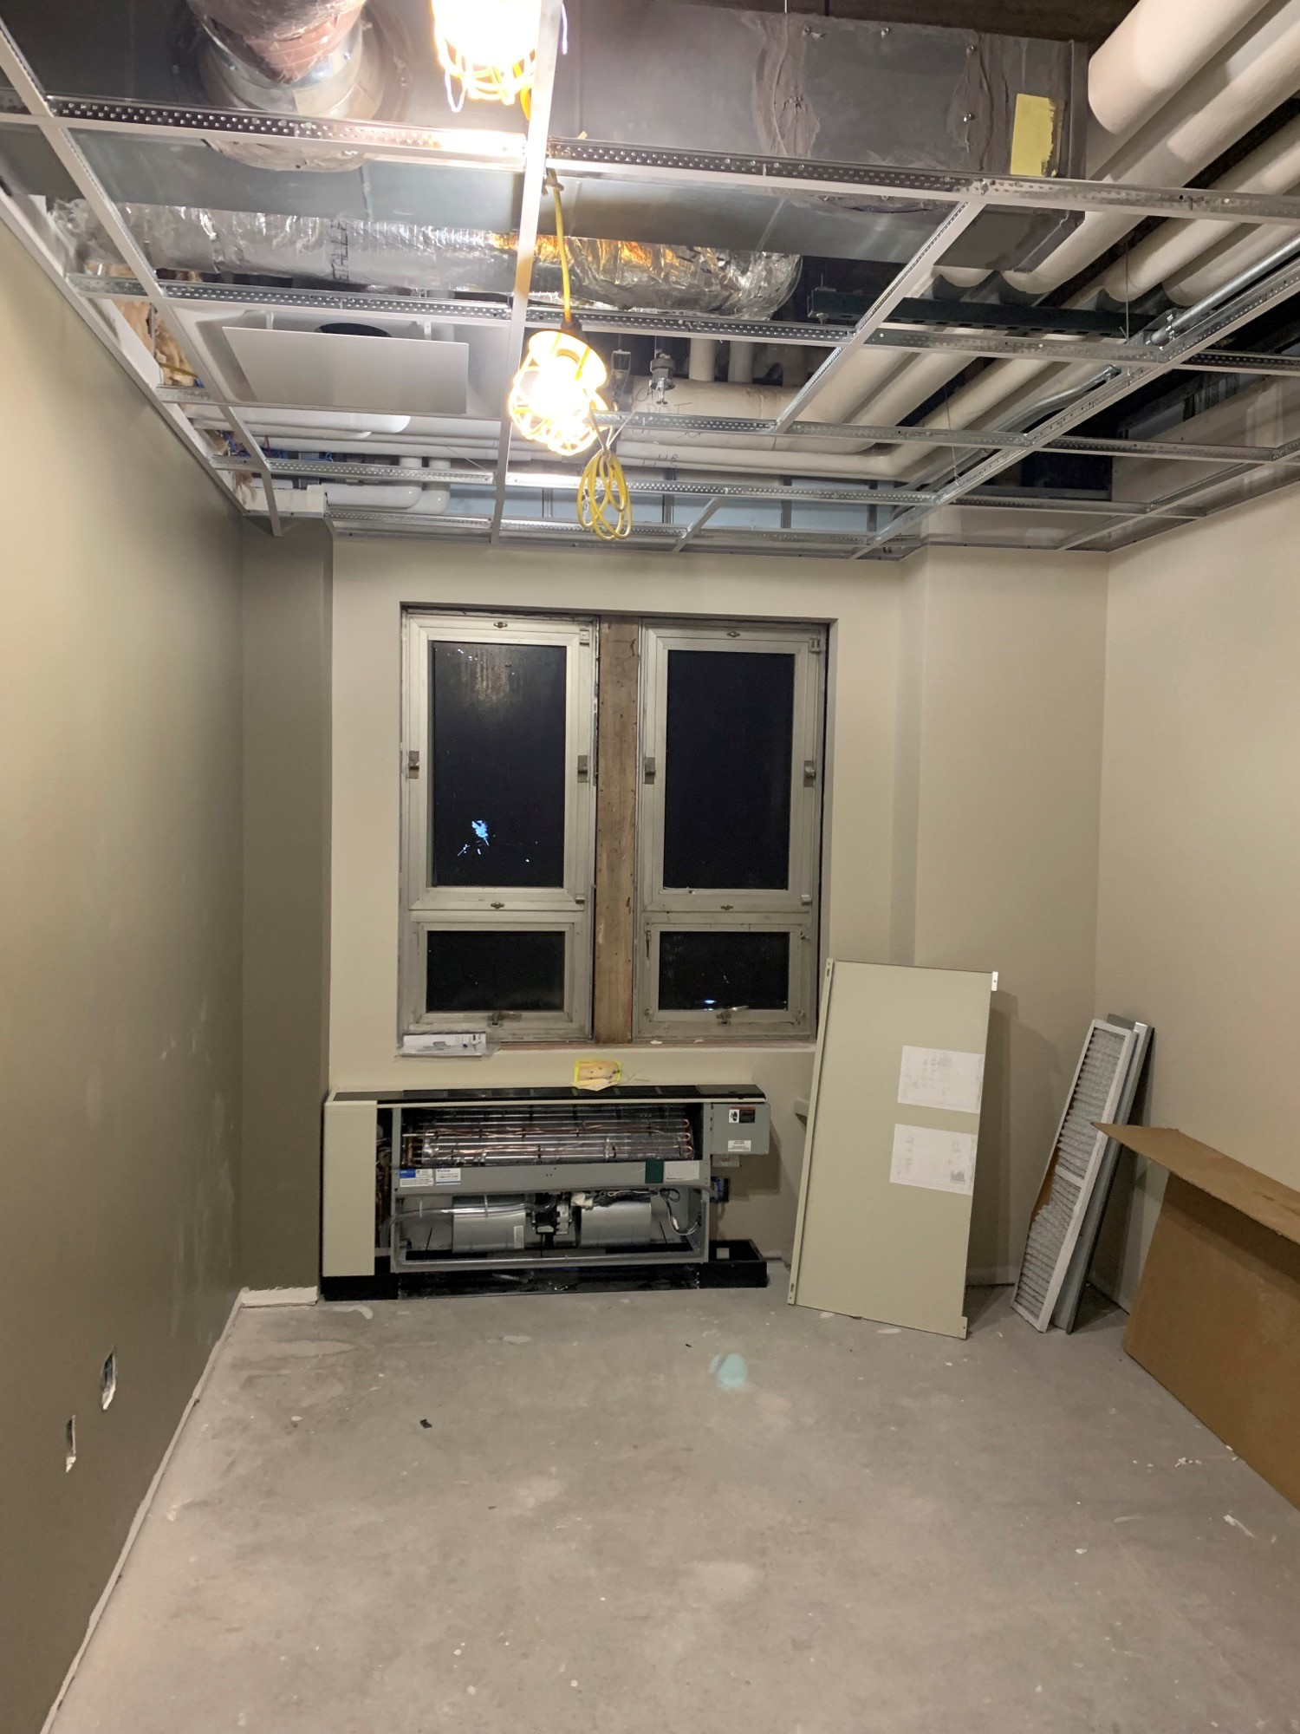
How to enter a service request
Presented by:
Hillary Robertson &
Joseph (Joe) Franklin

Slide 2
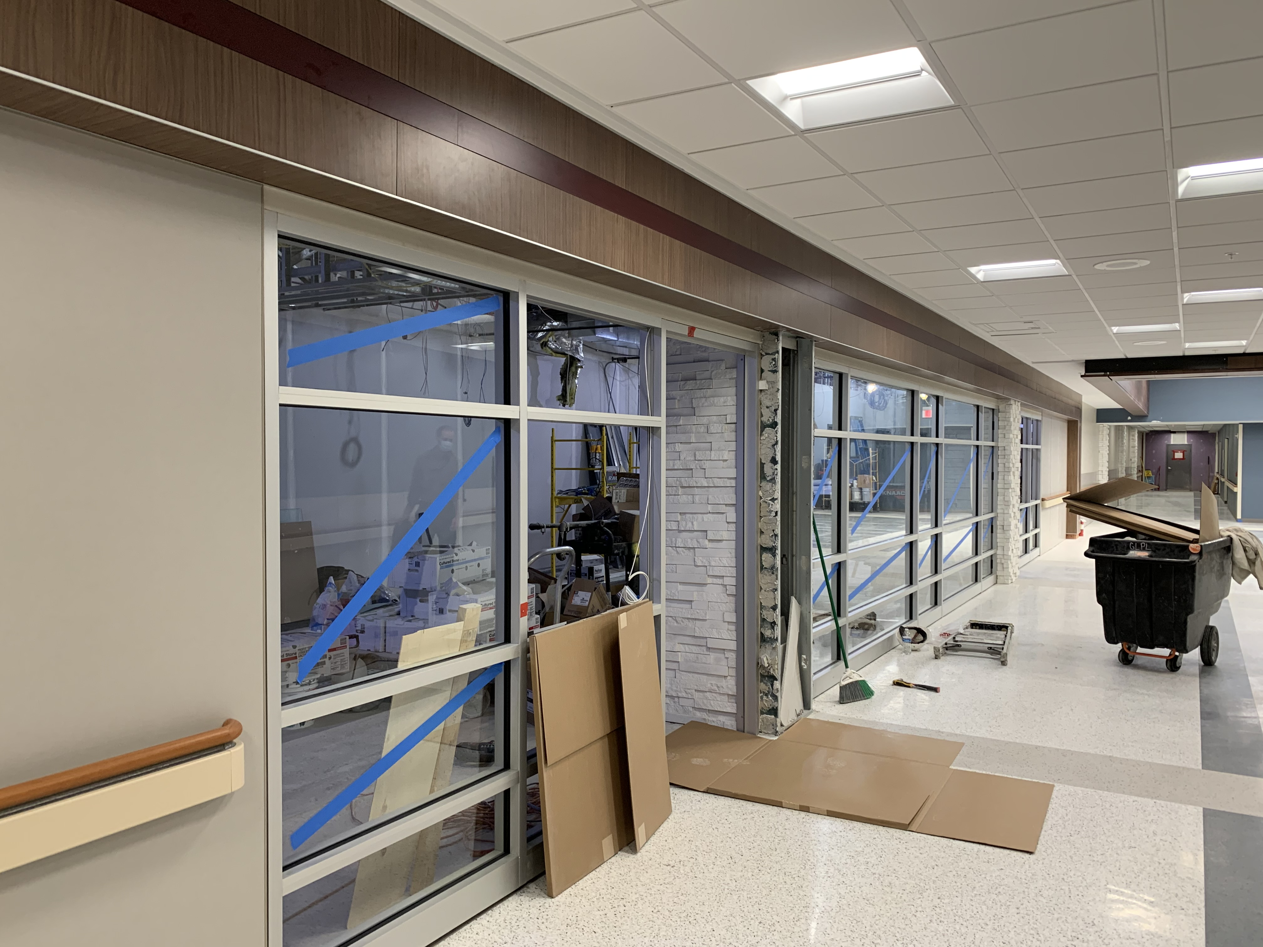
Agenda
What is a Service Request?
What is NOT a Service Request
Why do I have to use Maximo?
Service Request Categories.
Current Numbers
Step by step how to enter a Service Request

Slide 3
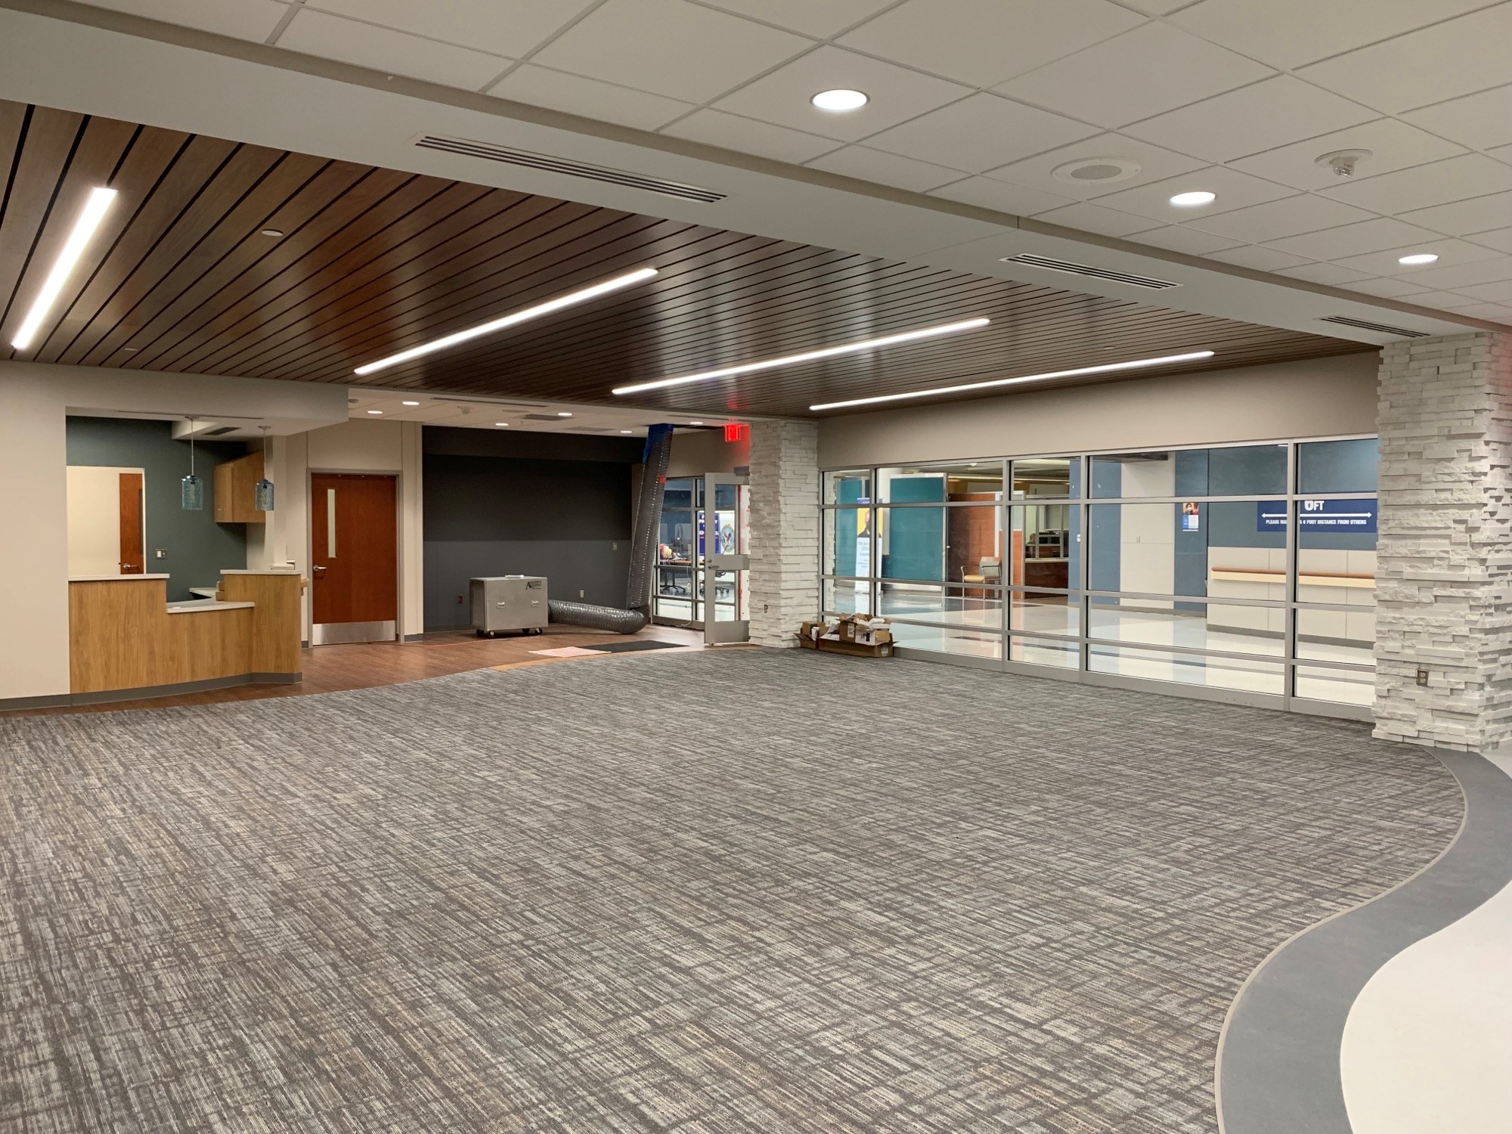
Introduction
To relate to a clinical mindset, think of a Service Request as a consult/referral from your Primary Care doctor.
Each “Issue” would require a referral to a specialty clinic (in this case think of the “Maximo Service Request” as the consult, and the different shops as the various specialty clinics).
Each request needs to be separate and documented to ensure the “issue” is resolved by a subject matter expert in their field; then tracked to ensure issue resolution and customer satisfaction.
​

Slide 4
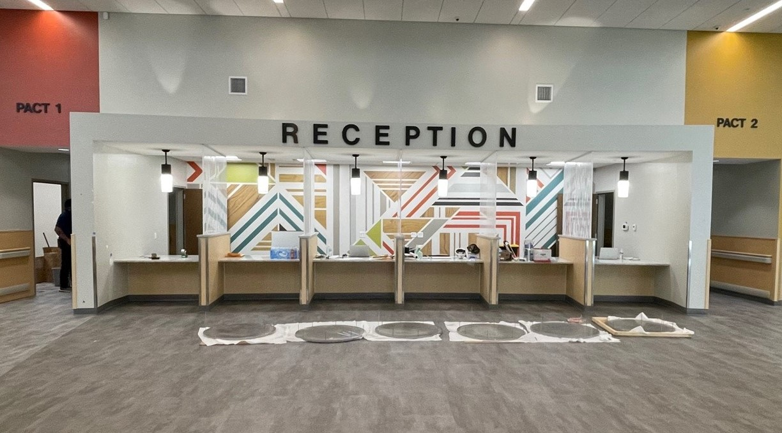
What is a Service Request?
Why does my service have to enter one?

Slide 5
What is a Service Request?
A Service Request (SR) IS:
Repair of a facility or infrastructure item. (“something’s broke, come fix it”)
Request for a small facility modification. (“I need something new or changed”)
A request (not everything can be approved)
A request for one shop (can’t combine multiple crafts) (think like a consult)
A Service Request is NOT...
Anything more than small facility changes or changes in function
(refer to SCRIPT Project Request process)
Anything regarding OI&T (submit “yourIT” trouble ticket)
OI&T related issues, equipment requests, application access, and all phone related issues

Slide 6
Why do I have to enter it in Maximo?
How does Maximo help FMS?
Maximo helps us track ownership, progress, and completion.
Maximo helps us collect data on the health of our facility.
Maximo helps us document for audits, TJC, inspections, etc.
FMS Completes ~25,000 work orders/year.
How does Maximo help me?
Maximo helps you get the right SME to fix your issue (just like a consult)
Maximo documents issues for your records and ours. (helpful for TJC, audits, and inspections)

Slide 7
Service Request Volume

Slide 8
Step by step, how to create a Service Request.

Slide 9
What if I’m not in Maximo?
Please send an Email to Robert.Lewis2@va.gov Robert (Todd) Lewis requesting Access to Maximo.
Please also CC janice.shank@va.gov & Hillary.Robertson@va.gov
We will ensure you are added to the system.
Please ensure your service has adequate access to Maximo based off the shift schedule, and the unique needs of your Service.

Slide 10
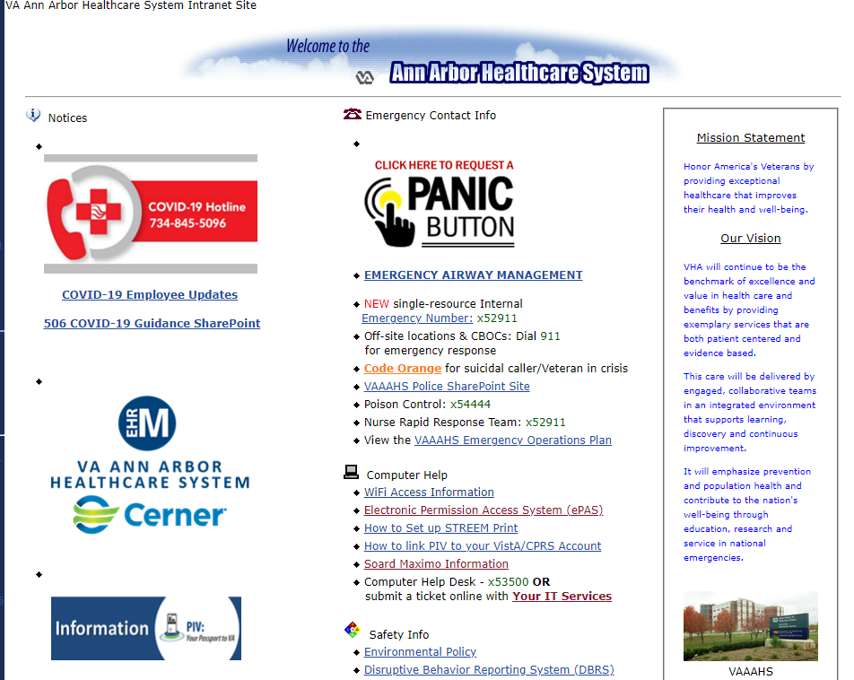
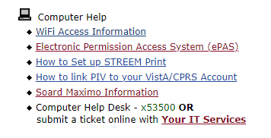
Where do I go to access Maximo?

Slide 11
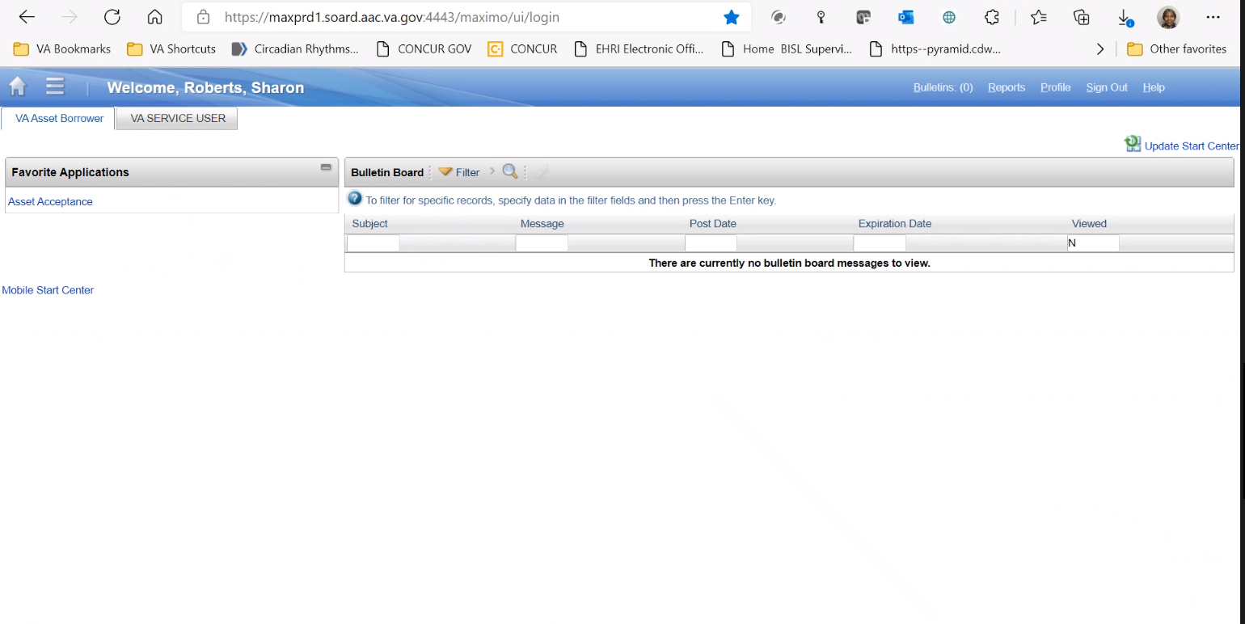
Ensure you click VA Service User Tab to begin.

Slide 12
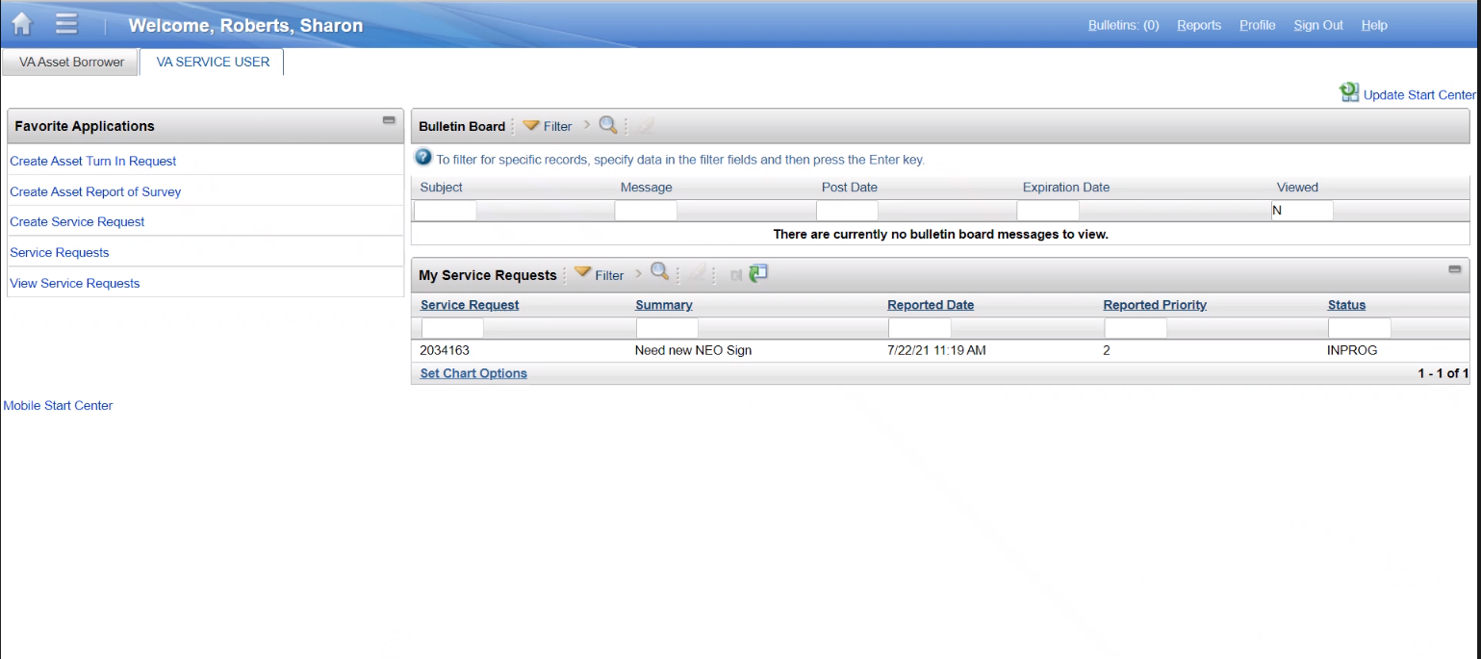
Select Create Service Request

Slide 13
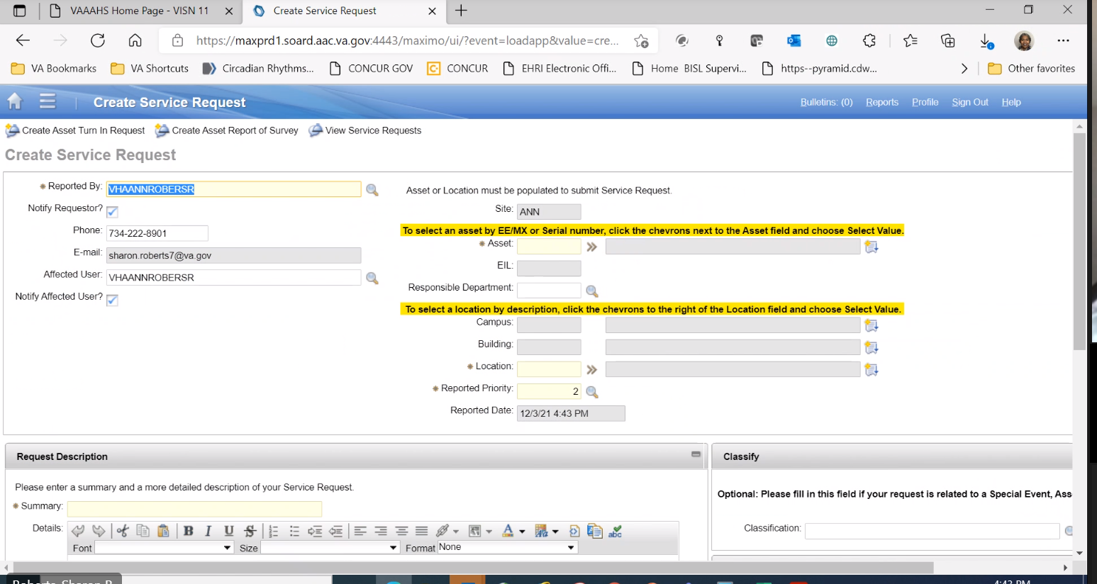
Ensure to Enter Asset # or Room #
One or the other, not both. Most Service Requests will require a location only.
Ensure you are as specific as possible. If you can’t find your exact room number in the drop down; ensure description of room is listed in the Summary & Details (ex. Hallway outside of room 207A).

Slide 14
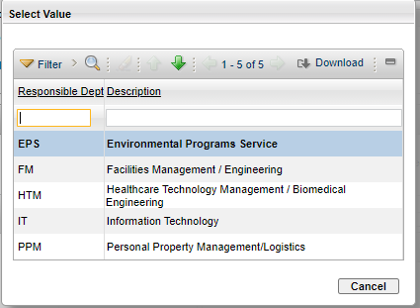
Select Department: FM, EPS or HTM
Click on magnifying glass next to responsible department
This will pop up,
Select Department

Slide 15
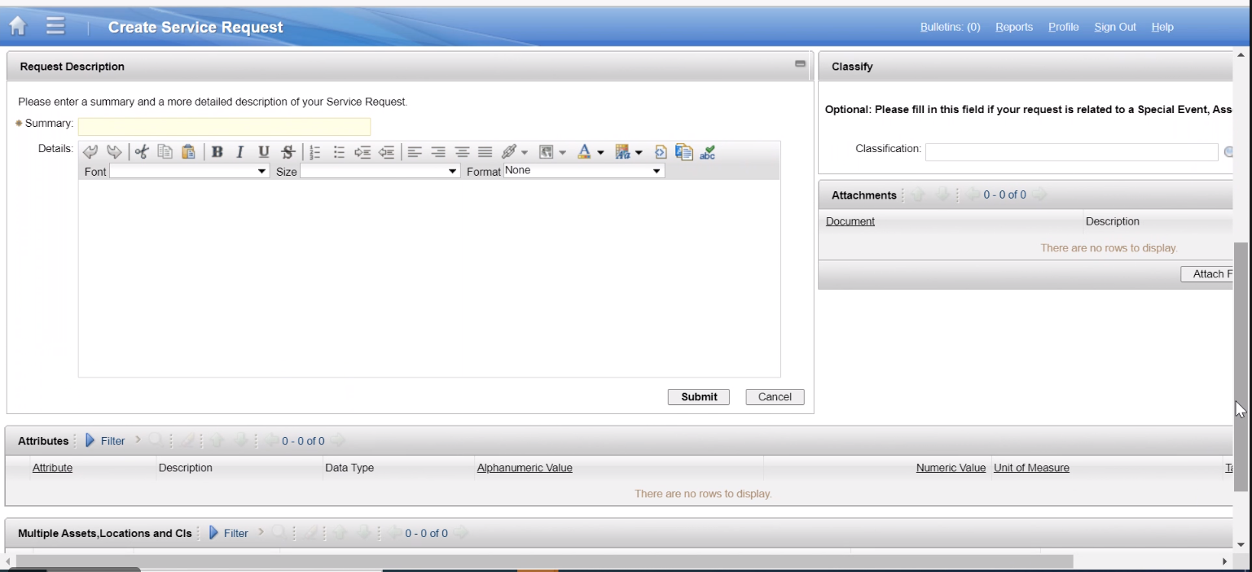
Summary
Briefly Describe Issue

Slide 16
Details
Most important part of a Service Request. Information entered here, directly affects processing time and issue resolution.
The more accurate and detailed information you provide, the better the results will be.

Slide 17
Attach Pictures
Pictures Say 1000 Words

Slide 18
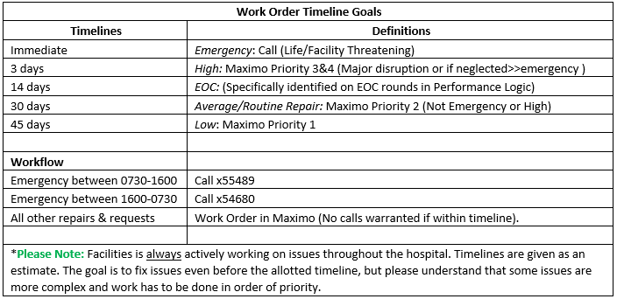
When is a realistic timeframe I can expect my Service Request to be completed by?

Slide 19
Priority
Enter your priority.
*Note: FMS is the final determiner of priority.

Slide 20
Submit
Once you have completed all required fields. Click here.

Slide 21
My SR got Closed but Nothing Happened?
A few scenarios can lead to this...
Not all Service Requests can be approved (due to limitations or the scale of the issue)
There’s a misunderstanding of how something should function.
Miscommunication within FMS…
What to do if you think your SR was improperly closed
Call x55489 and we can look into it
The key to all of this is communication
We need to communicate with the requester
The requester needs to communicate with us

Slide 22
Service Request Process Summary
If issue is truly a resolvable issue through a Service request. Enter a Service Request in Maximo.
Most important part of a Service Request. Information entered here; directly affects processing time and issue resolution.
The more accurate and detailed information you provide, the better the results will be for your service. Once this is complete submit request.
Identify issue within your Service.
What is the correct way to resolve my issue?
Mandatory
Fields
Issue
Maximo
Summary
& Details
Identify if the issue will be resolved through:
A Service Request - Carpentry, Plumbing, Electric, Electronics, Interior Design, Grounds, BIOMED.
A “yourIT” trouble ticket ~ IT related issues/requests, equipment requests, application access, and all phone related issues.
Ensure an asset # OR room # is provided in the mandatory fields. Only one is required, choose the option most applicable to your specific need/issue.
As long as a room # is provided the asset # will not be required.

Slide 23
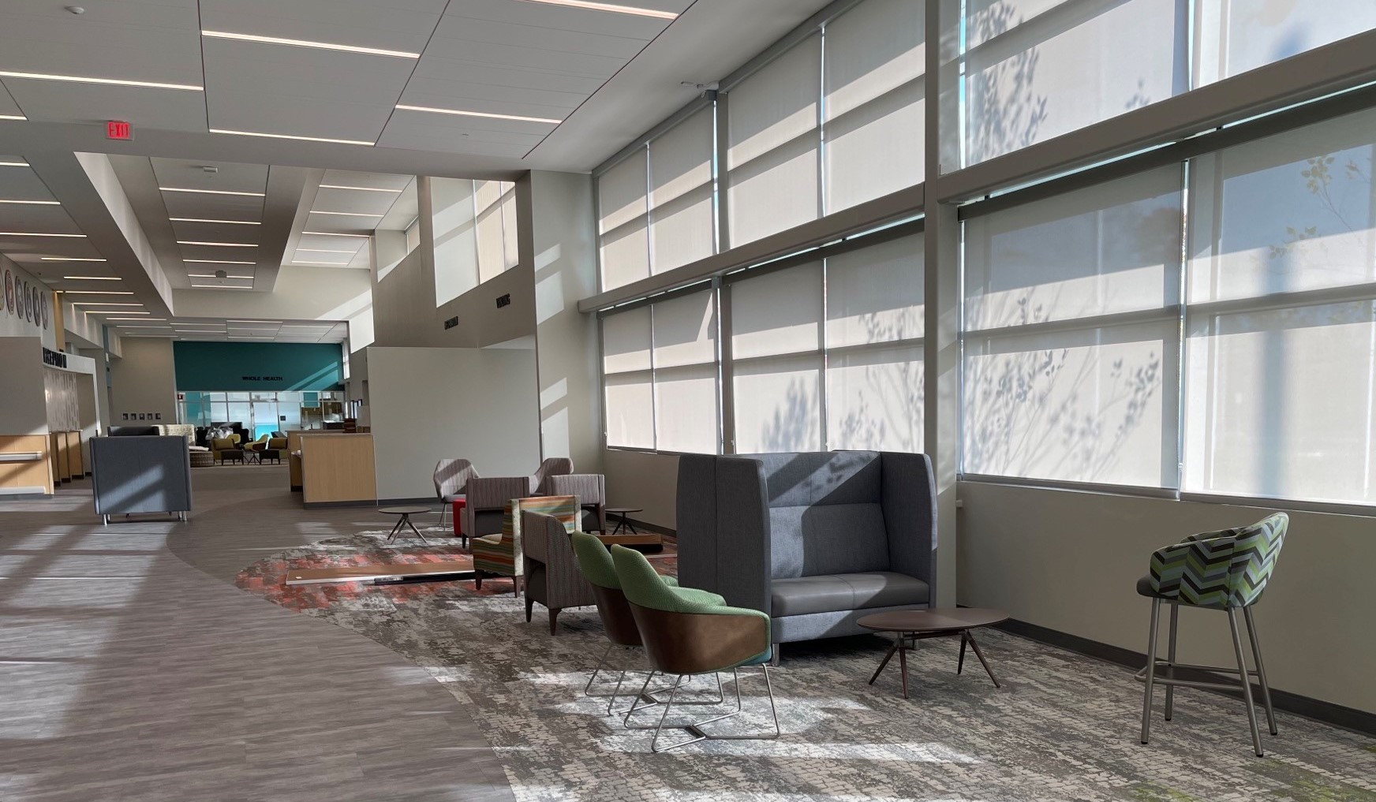
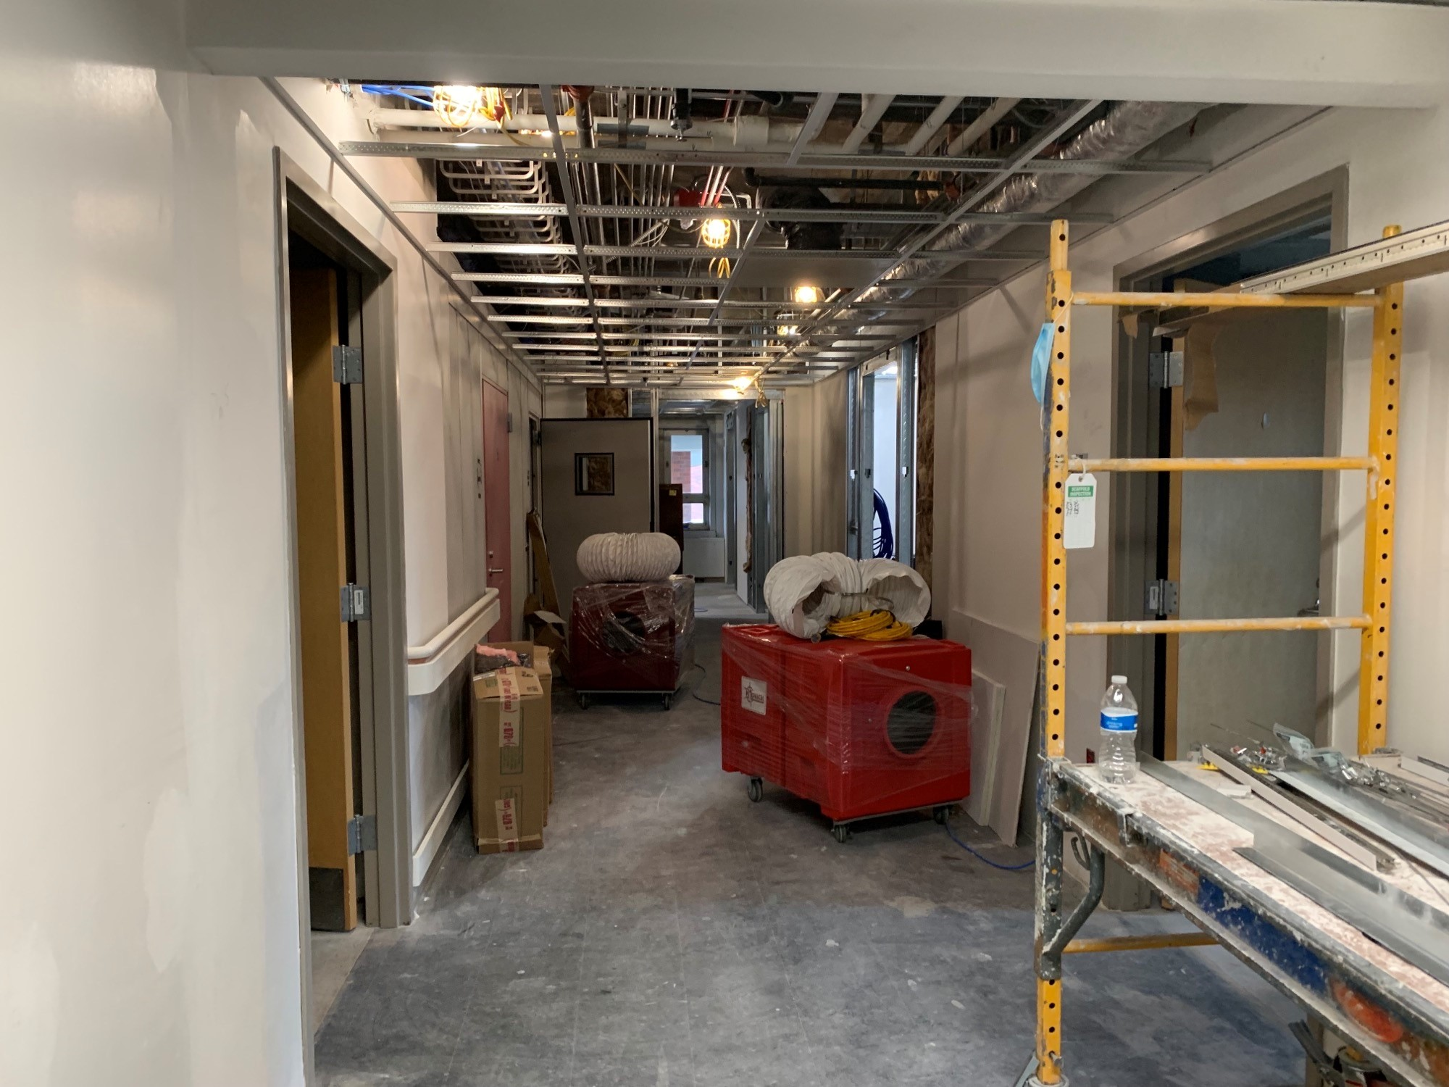
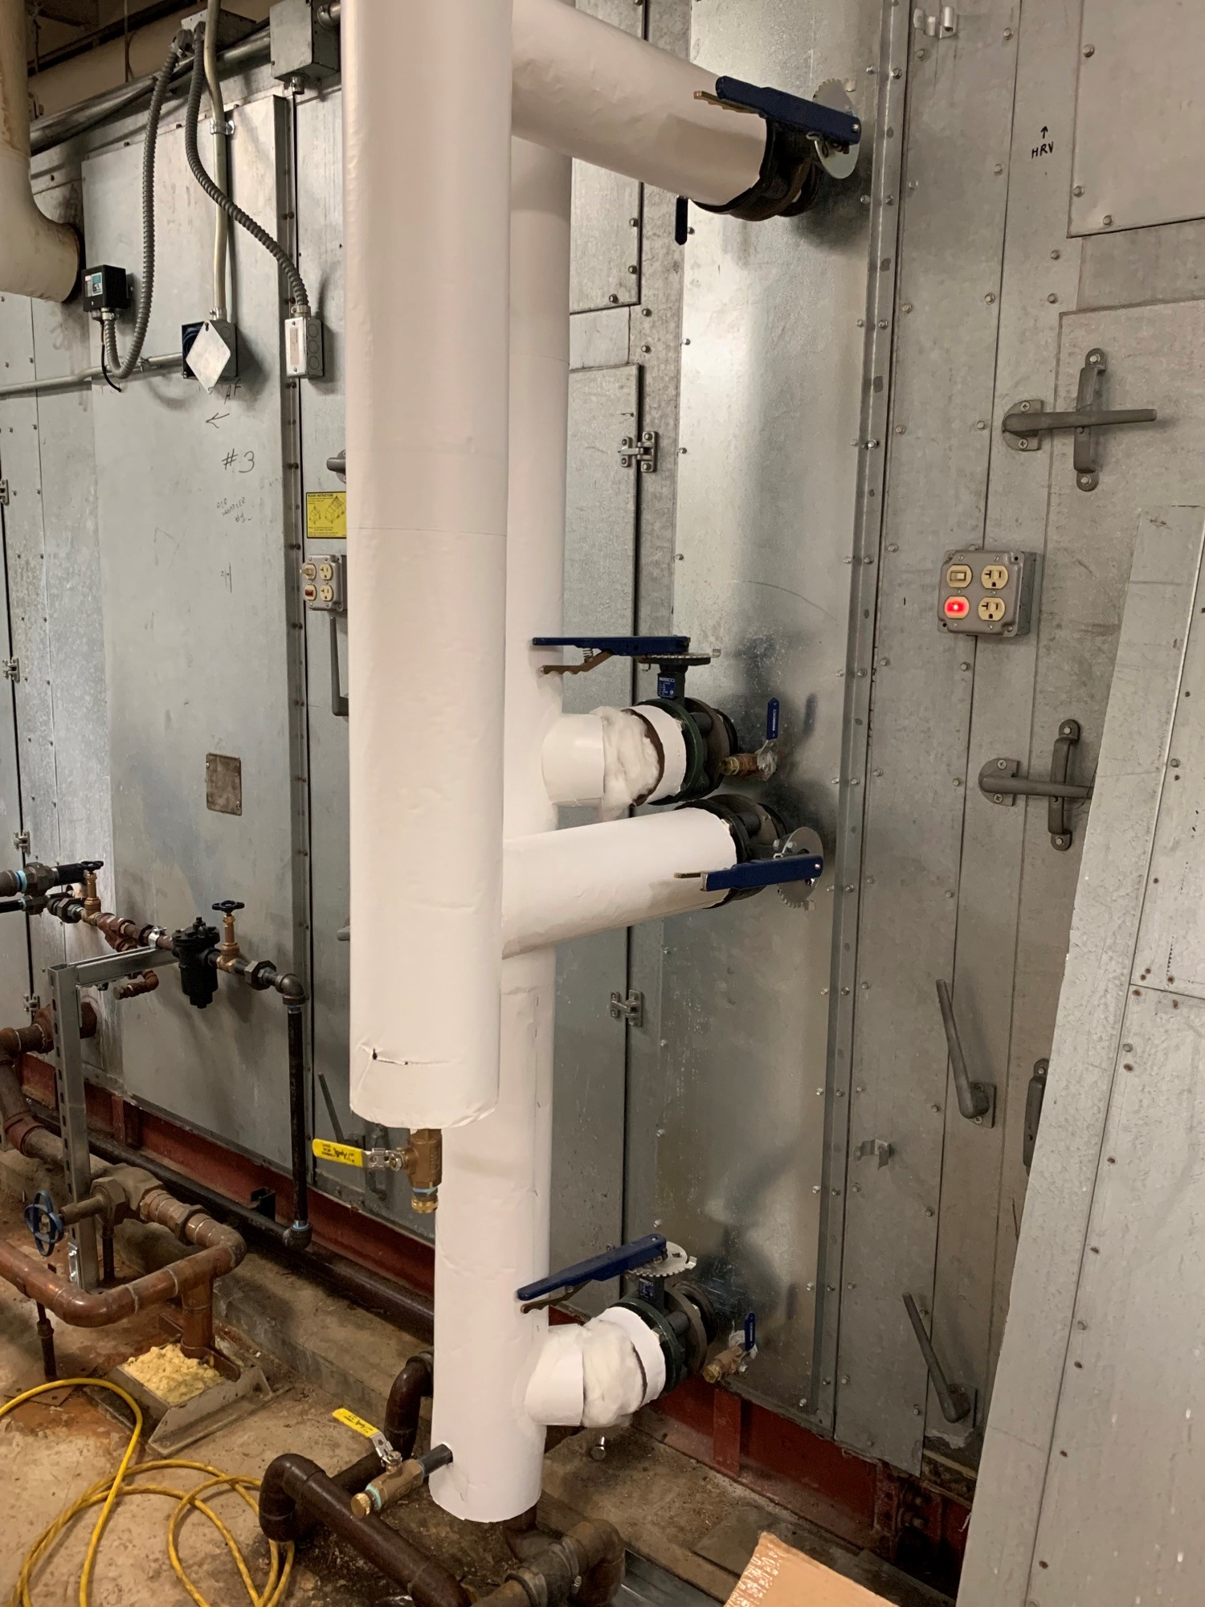
Summary
What is a Service Request?
What is NOT a Service Request
Why do I have to use Maximo?
Service Request Categories.
Current Numbers
Step by step how to enter a Service Request

Slide 24
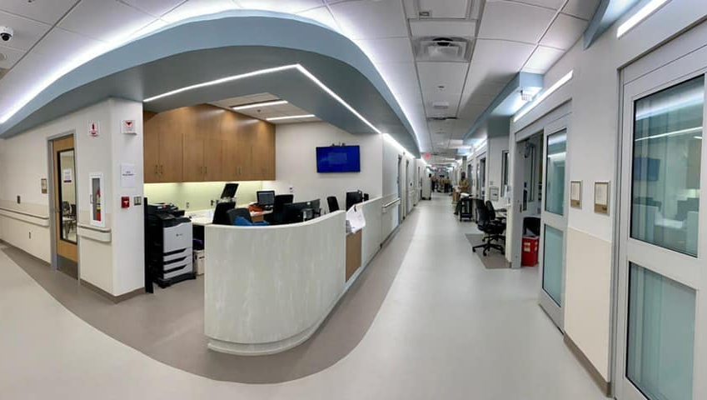
THANK YOU
Questions?

Slide 25
Examples of Service Request Categories
BIOMED
Carpentry
Electric
Electronics
Environmental Programs Services
Grounds
Interior Design
Plumbing

Slide 26
BIOMED Service Request
Examples:
Evoqua water system has a slow leak
Medica 15 water system crack in fitting leaking, cast cutter (filter changed & sticker)
Pulse ox broken off inside of plug
Olympus CYF failed leak test
Blood pressure cuff worn rubber needs repair
Oxygen cable shows error message
Broken WOW scanner
Demand button on PCA Pump not lighting up
Slit table wobbles
Calibrate stand up scale
Patient (ceiling) lift isn’t working
Printer not printing on cassette (if it’s piece of medical equipment)
MAW cart med display
PET camera down
Replace lift battery

Slide 27
Carpentry Service Requests
Examples:
Door will not latch
Window cracked
Veri Desk Requests
Locks not operating properly
Doorstop Missing
Computer mount requests
Penetration in drywall
Paint repair needed in patient room
Floor Tile damaged/missing
Window does not lock
Office desk damaged
Remove overhead storage bin
Deliver table for event display
Deliver moving crate

Slide 28
Electric Service Request
Examples:
Outlet missing cover
Personally owned electronic device inspections
Outlet modifications
Power outages
Tripped circuits
extension cord requests
Ethernet outlets
Electric smell, or blown fuses
damaged wiring
lightbulb replacement
Fire hazards
28

Slide 29
Electronics Service Request
Examples:
Nurse call,
Wander guard,
Sound system,
Patient TV issues
Tube system

Slide 30
Grounds
Examples:
Snow removal
Ice mitigation
Parking area related issues
General up-keep of Facility Grounds
Litter

Slide 31
Interior Design
Examples:
New Office Furniture
Office layout Modification
Office Use modification
Ordering New White Board
Order specific replacement furniture
Repaint Room
Renovations
Calander Boards
New Carpet requests
New Flooring requests

Slide 32
Plumbing Service Request
Examples:
Plumbing Leaks
Faucets that will not turn off
Overflowing toilets, urinals
Gas leaks
Sewer/Gas Odors
Broken Sinks
Broken water fountains

